Slide 1
COHORT – 114
MENTOR : Mr. BOSE
ASSIGNMENT 1 : DATA ANALYSIS
PROBLEM STATEMENT : COVID 19 AND IT’S IMPACT ON EDUCATIONAL, SOCIAL LIFE AND MENTAL HEALTH OF STUDENTS
STUDENT NAME : SHRUTHI ASTAKAR SHEKAR
SUBMISSION DATE : 22ND DEC,2024 [12 PM]

Slide 2
Google Survey Form : https://forms.gle/oWooVdwLJgDvUbRv8
SECTION 2 : IMPACT ON SOCIAL LIFE
Did the Social Distancing Measures make you feel isolated / lonely a. Yes b. No
What did you do keep yourself connected with your family/relatives/friends?
How much time you spent daily on social media
What social media platforms did you use
Has Pandemic affected the way you interact with people a. Yes b. No
How Comfortable are you now to attend social gatherings a. Comfortable b. Not-Comfortable
Does it bother and scare you to this day when anyone around you sneezes a. Yes b. No
SECTION 3 : IMPACT ON PHYSICAL AND MENTAL HEALTH
Did you fall sick during pandemic due to Covid related or Non Covid Related a. Covid b. Non-Covid c. Did not fall sick
What Physical activity did you like doing
How Much time did you spend on any Physical Activity
Did you notice any change in your sleep pattern
How long did you sleep each night.
Did any of your previous mental condition (if any) get triggered during pandemic a. Yes b. No c. N/A
Did pandemic help you develop any new skill / hobby a. Yes b. No
8. What activities did you do to keep your mental health in good shape
SECTION 1 : IMPACT ON EDUCATION
Age of the Student
Region where the student lives
Type of School a. Public (Government) b. Private
Did you find it challenging to transition from in-person teaching to Online Class teaching? a. Yes b. No
Platform used to join online Classes a. Zoom b. Microsoft Teams c. Google Meet d. Others
Device used for attending Online Class a. Laptop / Desktop b. Tablet c. smartphone d. Others
How much time did you spend Daily on Online Classes in Hrs.
How Effective was the Online teaching a. Poor b. Average c. Good
What Challenges did you face in Online Classes a. Lack of Internet Connection b. Lack of Proper Device c. Difficulty Concentrating d. Technical Issues e. Disturbances at home
How did your grades change with the Online Teaching a. Increased b. Decreased c. Stayed the same.
Was it easy to ask questions and get your doubts clarified by your teacher a. Yes b. No

Slide 3
REPORT ON COVID 19 AND IT’S IMPACT ON EDUCATIONAL, SOCIAL LIFE AND MENTAL HEALTH OF STUDENTS
The Report that is presented in the next 4 slides have been analyzed using the sample data provided the mentor by Mr. Bose
And with the little basic knowledge I have on Tableau that I just learnt.
Data Source: Survey Student Responses.csv
Tool used to create the Dashboard / Report : Tableau Public [ With basic knowledge I have on Tableau ]
Links to Dashboards I created on Tableau Public
Dashboard 1 : https://public.tableau.com/app/profile/shruthi.astakar.shekar/viz/COVID-19anditsimpactoneducationsocialandmentalhealthofstudents/Dashboard1?publish=yes
Dashboard 2 : https://public.tableau.com/app/profile/shruthi.astakar.shekar/viz/COVID-19anditsimpactoneducationsocialandmentalhealthofstudents/Dashboard2?publish=yes
Dashboard 3 : https://public.tableau.com/app/profile/shruthi.astakar.shekar/viz/COVID-19anditsimpactoneducationsocialandmentalhealthofstudents/Dashboard3?publish=yes
Dashboard 4 : https://public.tableau.com/app/profile/shruthi.astakar.shekar/viz/COVID-19anditsimpactoneducationsocialandmentalhealthofstudents/Dashboard4?publish=yes

Slide 4
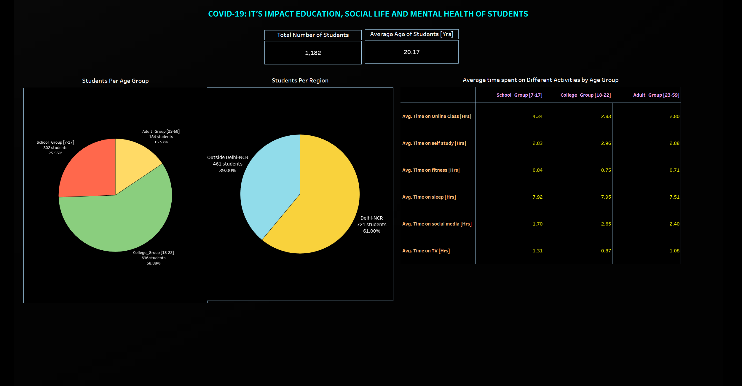

Slide 5
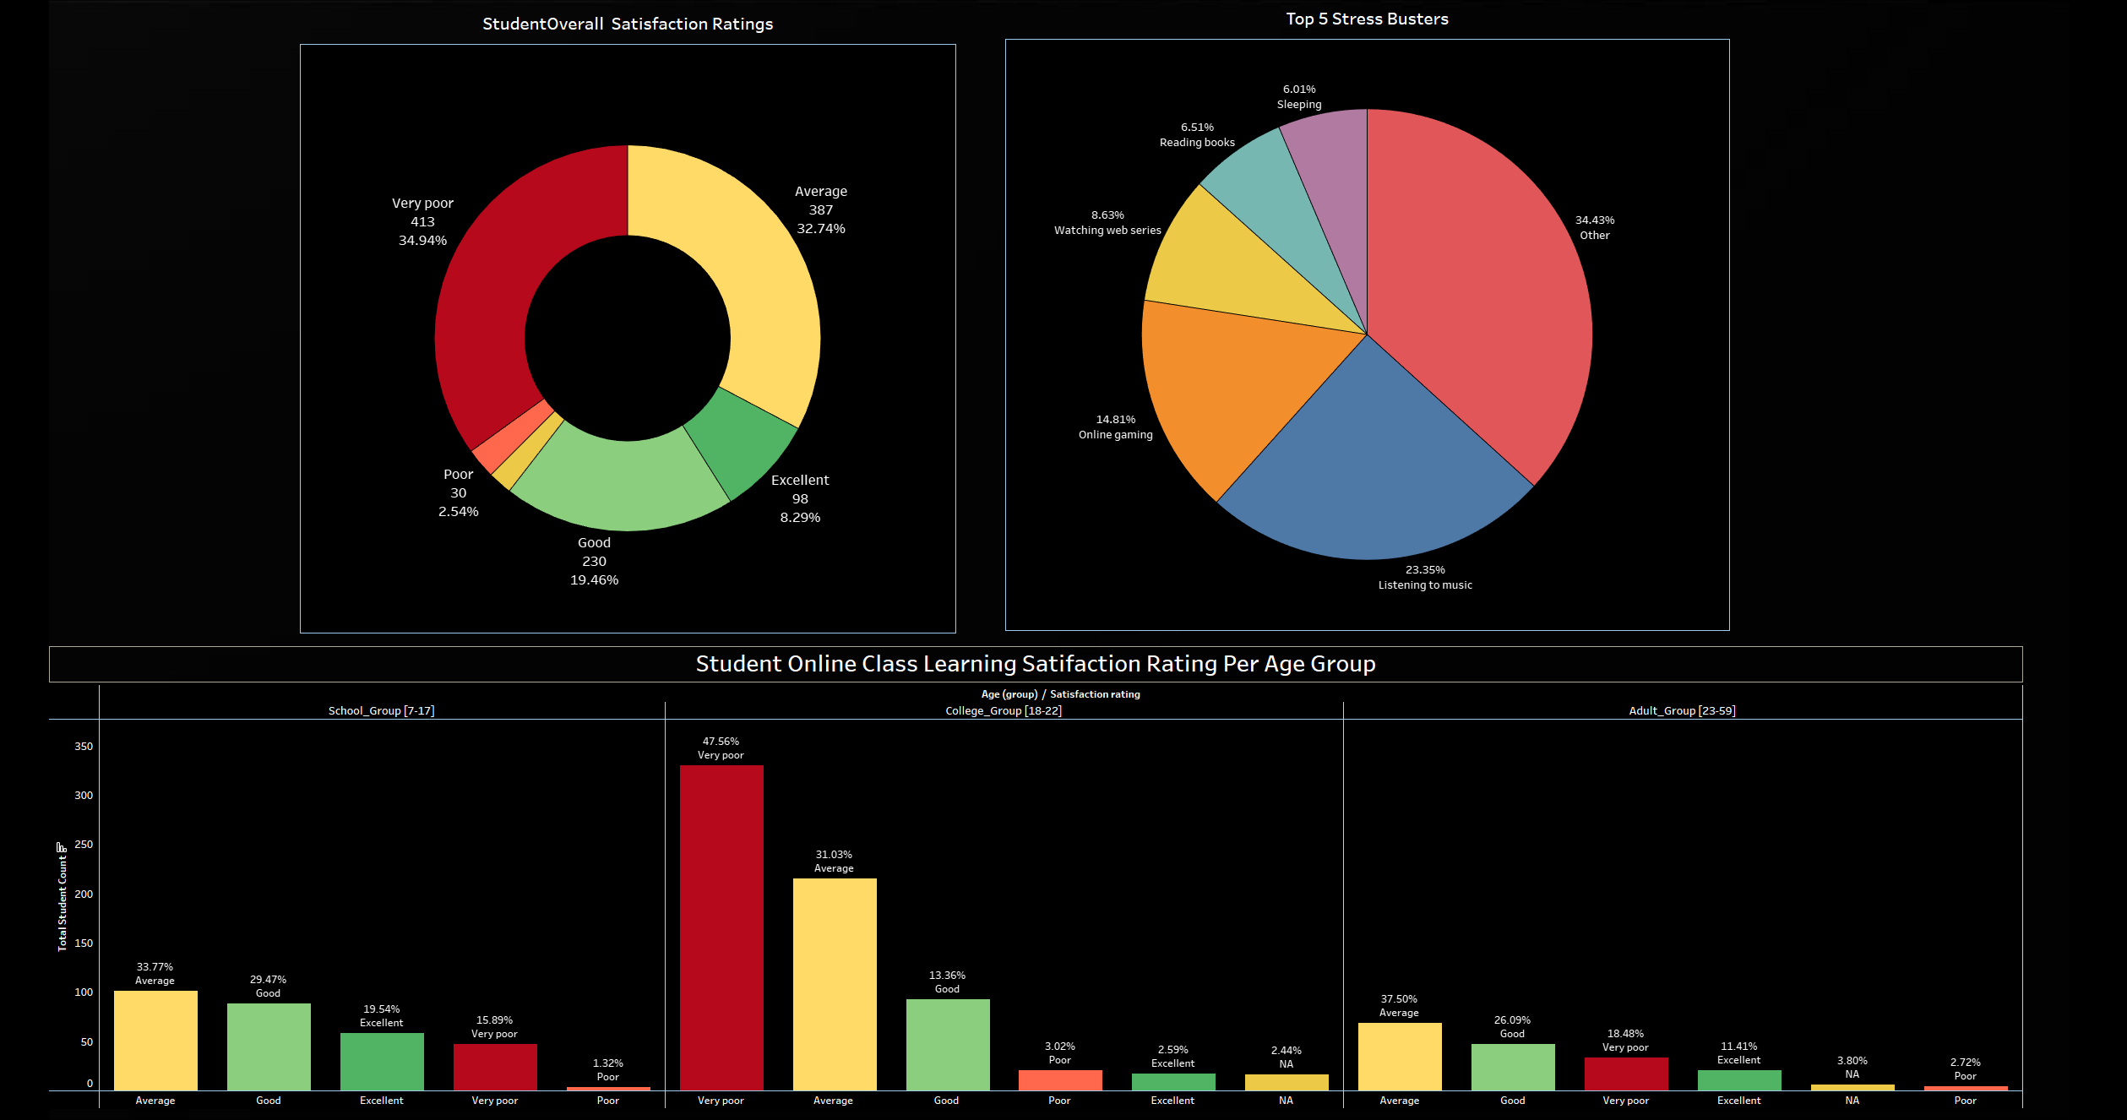

Slide 6
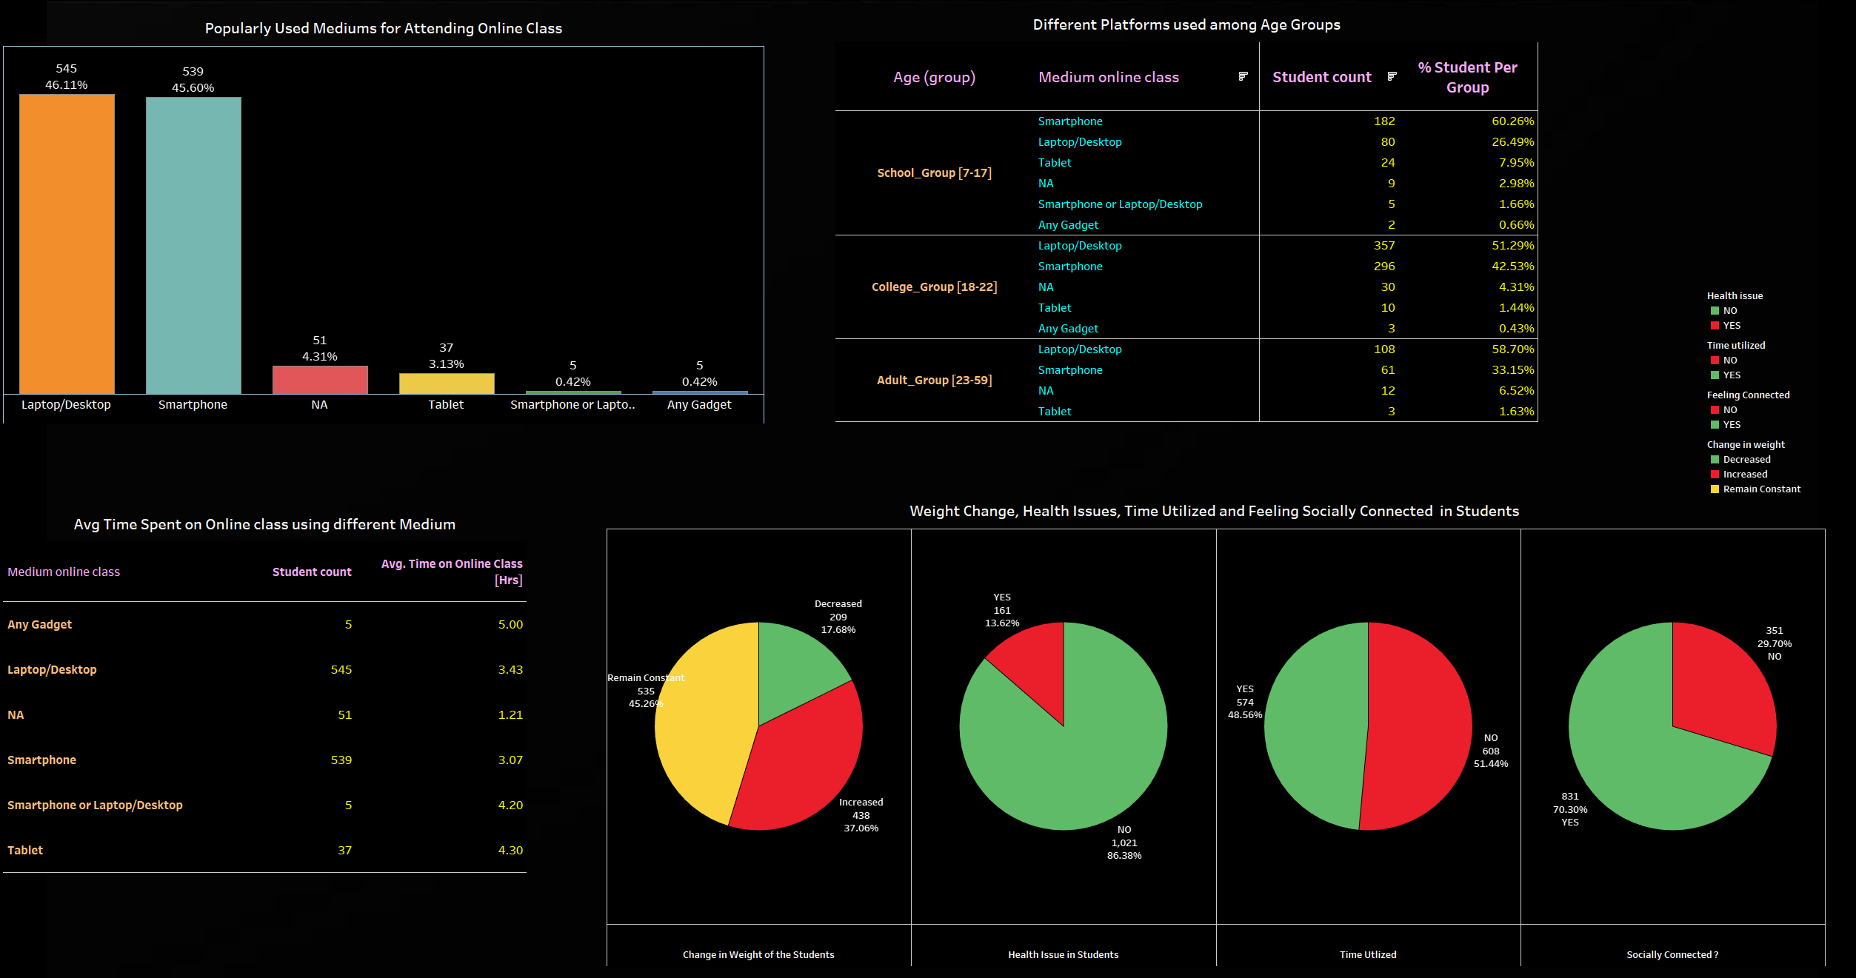

Slide 7
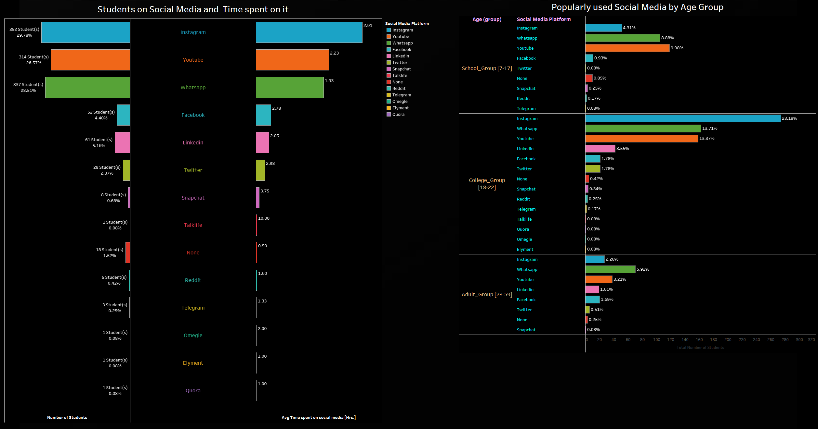

Slide 8
INSIGHTS FROM THE COVID-19 SURVEY
Total Number of Students participating in the Survey = 1182
The age of students ranged from 7 – 59 yrs.
Average age of students = 20.17 years
Geography of students – Majority of them lived in Delhi NCR - Delhi NCR – 61% [ 721 students] - Outside Delhi – 39% [461 students]
Majority of student responses came from Age Group 18-22 [ I called them “College Group”]. They make 58.88% of total students
Fewer responses came from students of Age Group 23-59 [ I called them “Adult Group”]. They represent 15.57% of total students
Average time spent on daily online class is HIGHER for Age Group 7-17 [ I called them “School Group”] with 4.34 Hrs. and lower for other 2 age groups
Average time spent on Self study was relatively close in all Age groups
Overall Satisfaction rate is – “VERY POOR”, i.e., 34.94% Only 27.75% of students have given Positive satisfaction Rating
Age Group 18-22 [College Group] gave the highest Negative Satisfaction Rating
Age Group 7-17 [School Group] gave the highest Positive Satisfaction Rating
12. Top 5 Stress Busters
-Listening to Music – 23.35% -Online Gaming – 14.81% -Watching Web Series – 8.63% -Reading books – 6.51% -Sleeping – 6.01%
13. Most used Devices for Online Class - Overall - Laptop/Desktop - 46.11%
14. Highly Used devices from each Age Group -Age Group 7-17 [School Group] - Smartphone : 60.26% -Age Group 18-22 [College Group] – Laptop/Desktop : 51.29% -Age Group 23-59 [Adult Group] – Laptop/Desktop : 58.70%
15. Health conditions of Students - 13.62 % of Students faced Health issues during the pandemic - 86.38 % of Students DID NOT face Health issues during the pandemic - 37.06 % of Students INCREASED in their weight during the pandemic - 17.68 % of Students DECREASED in their weight during the pandemic - 45.26 % of Students weight REMAINED THE SAME during the pandemic
16. Time Utilized by Students - 48.56 % of Students Utilized their time well during the pandemic - 51.44 % of Students DID NOT Utilized their time well during the pandemic
17. Feeling Socially connected - 70.30 % of Students reported they were Socially Connected during the pandemic - 29.70 % of Students reported they were NOT Socially Connected during the pandemic
18. Top 4 Social Media platform used during Pandemic 1. Instagram – 29.7% Students spent 2.91 Hrs. on an average Daily on Instagram 2. YouTube – 26.57% Students spent 2.23 Hrs. on an average Daily on YouTube 3. WhatsApp – 28.51% Students spent 1.93 Hrs. on an average Daily on WhatsApp 3. Facebook –4.40% Students spent 2.78 Hrs. on an average Daily on Facebook
19. 1.52% of the Students did not spend any time on any social Media platforms
20 . Highly Used Social Media Platforms from each Age Group -Age Group 7-17 [School Group] - YouTube : 39.98% -Age Group 18-22 [College Group] –Instagram : 39.37% -Age Group 23-59 [Adult Group] – WhatsApp: 5.92%

